Slide 1

What is CSS?
CSS stands for Cascading Style Sheets.
CSS describes how HTML elements are to be displayed on screen or in other media.
CSS saves a lot of work. It can control the layout of multiple web pages all at once.
External style sheets are stored in CSS files.

Slide 2
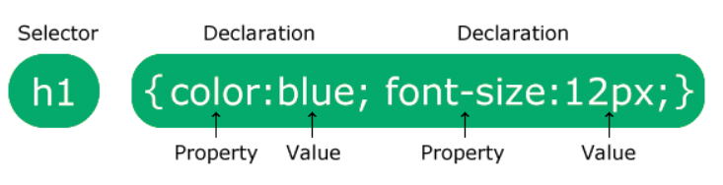
CSS Syntax
A CSS rule consists of a selector and a declaration block.
The selector points to the HTML element you want to style.
The declaration block contains one or more declarations separated by semicolons.
Each declaration includes a CSS property name and a value, separated by a colon.
Multiple CSS declarations are separated with semicolons, and declaration blocks are surrounded by curly braces.

Slide 3
CSS SELECTORS
Element Selector
ID Selector
Class Selector
Group Selector
Universal Selector

Slide 4
CSS Selectors
CSS selectors are used to "find" HTML elements based on their element name, id, class, attribute, and more.
The element Selector
The element selector selects elements based on the element name.
You can select all <p> elements on a page.
In this case, all <p> elements will be center-aligned, with a red text color.

Slide 5
Element Selector
<!DOCTYPE html>
<html>
<head>
<style>
p
{
text-align: center;
color: red;
}
</style>
</head>
<body>
<p>Every paragraph will be affected by the style.</p>
<p id="para1">Me too!</p>
<p>And me!</p>
</body>
</html>

Slide 6
The Id Selector
The id selector uses the id attribute of an HTML element to select a specific element.
The id of an element should be unique within a page, so the id selector is used to select one unique element!
To select an element with a specific id, write a hash (#) character, followed by the id of the element.

Slide 7
The Id Selector
<!DOCTYPE html>
<html>
<head>
<style>
#para1
{
text-align: center;
color: red;
}
</style>
</head>
<body>
<p id="para1">Hello World!</p>
<p>This paragraph is not affected by the style.</p>
</body>
</html>

Slide 8

The Class Selector
The class selector selects elements with a specific class attribute.
To select elements with a specific class, write a period (.) character, followed by the name of the class.

Slide 9
The Class Selector
<!DOCTYPE html>
<html>
<head>
<style>
.center
{
text-align: center;
color: red;
}
</style>
</head>
<body>
<h1 class="center">Red and center-aligned heading</h1>
<p class="center">Red and center-aligned paragraph.</p>
</body>
</html>

Slide 10
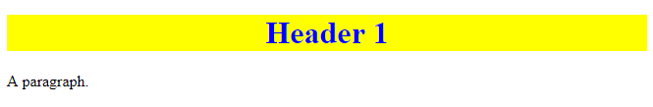
The Class Selector
<!DOCTYPE html>
<html>
<head>
<style>
.intro
{
color: blue;
text-align: center;
}
.important
{
background-color: yellow;
}
</style>
</head>
<body>
<h1 class="intro important">Header 1</h1>
<p>A paragraph.</p>
</body>
</html>

Slide 11
Group Selectors
<!DOCTYPE html>
<html>
<head>
<style>
h1, h2, p
{
text-align: center;
color: red;
}
</style>
</head>
<body>
<h1>Hello World!</h1>
<h2>Smaller heading!</h2>
<p>This is a paragraph.</p>
</body>
</html>

Slide 12
Universal Selectors
<html>
<head>
<title>Simple Example of CSS universal selectors </title>
<style>
*
{
color: blue;
background: silver;
}
</style>
</head>
<body>
<h1>Example of CSS.</h2>
<h2>Example of grouping of CSS universal selectors.</h2>
<p>CHAITANYA BHARATHI INSTITUTE OF TECHNOLOGY, established in the Year 1979, esteemed as the Premier Engineering Institute in the States of Telangana and Andhra Pradesh.</p>
</body>
</html>

Slide 13
Cascading Style Sheets
There are three ways of inserting a style sheet:
External style sheet
Internal style sheet
Inline style

Slide 14
External Style Sheet
With an external style sheet, you can change the look of an entire website by changing just one file!
Each page must include a reference to the external style sheet file inside the <link> element.
The style sheet file must be saved with a .css extension.
<link rel=“stylesheet” type=“text/css” href=“cbitexternal.css”>

Slide 15
External Style Sheet
<!DOCTYPE html>
<html>
<head>
<link rel="stylesheet" type="text/css” href=“cbitexternal.css">
</head>
<body>
<h1>This is a heading</h1>
<p>This is a paragraph.</p>
</body>
</html>

Slide 16
"cbitexternal.css"
body
{ background-color: lightblue; }
h1
{ color: navy; margin-left: 20px; }

Slide 17
Internal Style Sheet
An internal style sheet may be used if one single page has a unique style.
Internal styles are defined within the <style> element, inside the <head> section of an HTML page.
<head>
<style>
Selector
{
property: value
}
</style>
</head>

Slide 18
Internal Style Sheet
<html>
<head>
<style>
body
{
background-color: linen;
}
h1
{
color: maroon;
margin-left: 40px;
}
</style>
</head>
<body>
<h1>This is a heading</h1>
<p>This is a paragraph.</p>
</body>
</html>

Slide 19
Inline Styles
An inline style may be used to apply a unique style for a single element.
To use inline styles, add the style attribute to the relevant element. The style attribute can contain any CSS property.
<tag style=“property:value>content</tag>

Slide 20
Inline Styles
<!DOCTYPE html>
<html>
<body>
<h1 style="color:blue;margin-left:30px;">This is a heading.</h1>
<p>This is a paragraph.</p>
</body>
</html>

Slide 21
CSS Background Color
<html>
<head>
<style>
h1
{
background-color: green;
}
div
{
background-color: lightblue;
}
p
{
background-color: yellow;
}
</style>
</head>
<body>
<h1>CSS background-color example!</h1>
<div>
This is a text inside a div element.
<p>This paragraph has its own background color.</p>
We are still in the div element.
</div>
</body>
</html>

Slide 22
CSS Background Image
<html>
<head>
<style>
body
{
background-image: url("paper.gif");
}
</style>
</head>
<body>
<h1>Hello World!</h1>
<p>This page has an image as the background!</p>
</body>
</html>

Slide 23
CSS Background
background-color
background-image
background-repeat
background-attachment
background-position

Slide 24
The CSS Box Model
All HTML elements can be considered as boxes. In CSS, the term "box model" is used when talking about design and layout.
The CSS box model is essentially a box that wraps around every HTML element.
Each Rectangular Box contains 4 edges.
Content Edge
Padding Edge
Border Edge
Margin Edge

Slide 25
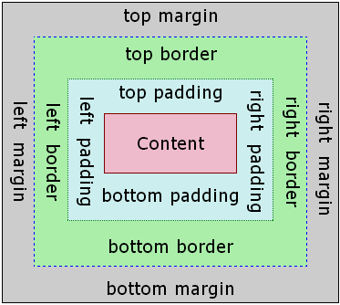
The CSS Box Model

Slide 26
The CSS Box Model
Content - The content of the box, where text and images appear.
Padding - Clears an area around the content. The padding is transparent.
Border - A border that goes around the padding and content.
Margin - Clears an area outside the border. The margin is transparent.

Slide 27
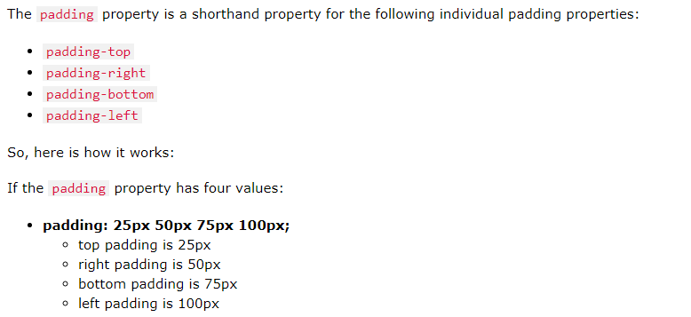




The CSS Box Model

Slide 28
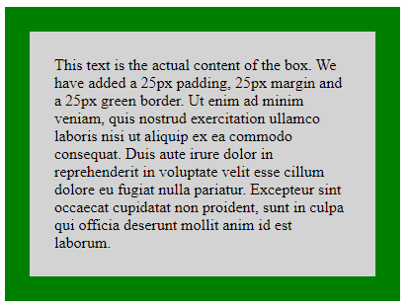
The CSS Box Model
<!DOCTYPE html>
<html>
<head>
<style>
div
{
background-color: lightgrey;
width: 300px;
border: 25px solid green;
padding: 25px;
margin: 25px;
}
</style>
</head>
<body>
<h2>Demonstrating the Box Model</h2>
<p>The CSS box model is essentially a box that wraps around every HTML element. It consists of: borders, padding, margins, and the actual content.</p>
<div>This text is the actual content of the box. We have added a 25px padding, 25px margin and a 25px green border. Ut enim ad minim veniam, quis nostrud exercitation ullamco laboris nisi ut aliquip ex ea commodo consequat. Duis aute irure dolor in reprehenderit in voluptate velit esse cillum dolore eu fugiat nulla pariatur. Excepteur sint occaecat cupidatat non proident, sunt in culpa qui officia deserunt mollit anim id est laborum.</div>
</body>
</html>

Slide 29
CSS POSITIONING
The CSS position property defines the position of an element where generally the top, right, bottom, and left properties will determine the position of the element.
However, these properties will not work unless the position property is set first. They also work differently depending on the position value.
position: value;

Slide 30
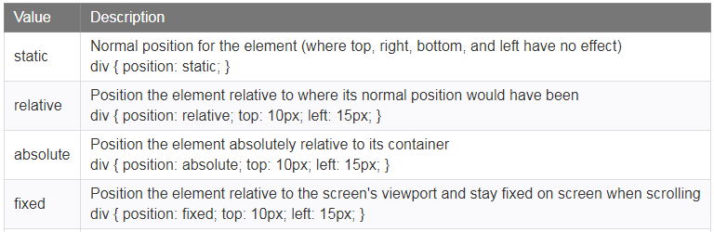
CSS POSITIONING

Slide 31
STATIC POSITION
position: static;
HTML elements are positioned static by default.
Static positioned elements are not affected by the top, bottom, left, and right properties.
An element with position: static; is not positioned in any special way; it is always positioned according to the normal flow of the page.

Slide 32
STATIC POSITION
<html>
<head>
<style>
div.static
{
position: static;
border: 3px solid #73AD21;
}
</style>
</head>
<body>
<h2>position: static;</h2>
<p>An element with position: static; is not positioned in any special way;</p>
<div class="static"> This div element has position: static; </div>
</body>
</html>

Slide 33
Relative Position
position: relative;
An element with position: relative; is positioned relative to its normal position.
Setting the top, right, bottom, and left properties of a relatively-positioned element will cause it to be adjusted away from its normal position.
Other content will not be adjusted to fit into any gap left by the element.

Slide 34
FIXED POSITION
position: fixed;
An element with position: fixed; is positioned relative to the viewport, which means it always stays in the same place even if the page is scrolled. The top, right, bottom, and left properties are used to position the element.
A fixed element does not leave a gap in the page where it would normally have been located.

Slide 35
FIXED POSITION
<html>
<head>
<style>
div.fixed
{
position: fixed;
bottom: 0;
right: 0;
width: 300px;
border: 3px solid #73AD21;
}
</style>
</head>
<body>
<h2>position: fixed;</h2>
<p>An element with position: fixed;</p>
<div class="fixed">
This div element has position: fixed;
</div>
</body>
</html>

Slide 36
ABSOLUTE POSITION
position: absolute;
Elements with position: absolute; are positioned relative to their parent elements.
That means that the parent element has to have a position value other than position: static.
However; if an absolute positioned element has no positioned ancestors, it uses the document body, and moves along with page scrolling.

Slide 37
ABSOLUTE POSITION
<html>
<head>
<style>
div.relative { position: relative; width: 400px; height: 200px; border: 3px solid #73AD21;}
div.absolute { position: absolute; top: 80px; right: 0; width: 200px; height: 100px; border: 3px solid #73AD21;}
</style>
</head>
<body>
<h2>position: absolute;</h2>
<p>An element with position: absolute; is positioned relative to the nearest positioned ancestor.</p>
<div class="relative">This div element has position: relative;
<div class="absolute">This div element has position: absolute;</div>
</div>
</body>
</html>

Slide 38
CSS Layout - Float and Clear
The float property specifies whether or not an element should float.
The clear property is used to control the behavior of floating elements.
The float property can be used to wrap text around images.

Slide 39
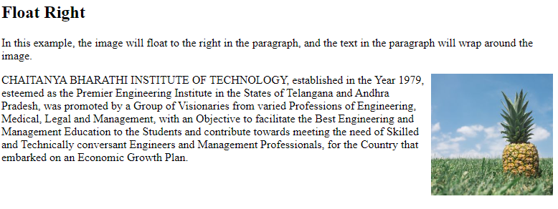
CSS Layout - Float and Clear

Slide 40
CSS Layout - Float and Clear
The clear property is used to control the behavior of floating elements.
Elements after a floating element will flow around it. To avoid this, use the clear property.
The clear property specifies on which sides of an element floating elements are not allowed to float.

Slide 41
CSS Grid Layout
The CSS Grid Layout Module offers a grid-based layout system, with rows and columns, making it easier to design web pages without having to use floats and positioning.
Display property is set to grid or inline-grid.
The gap property is a shorthand property for the row-gap and the column-gap properties.

Slide 42
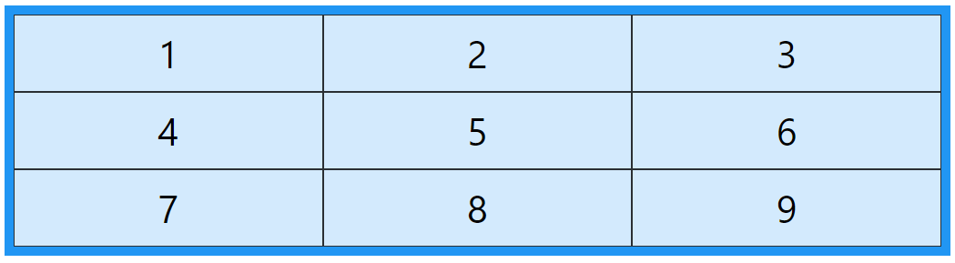
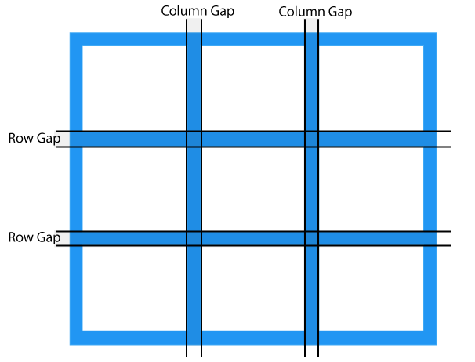
CSS Grid Layout

Slide 43
CSS Grid Layout
.grid-container
{
display: inline-grid;
grid-template-columns: auto auto auto;
background-color: #2196F3;
padding: 10px;
}
.grid-item
{
background-color: rgb(255, 255, 255);
border: 1px solid rgb(0, 0, 0);
padding: 20px;
font-size: 30px;
text-align: center;
}

Slide 44
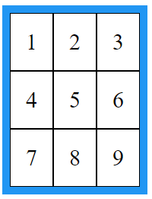
CSS Grid Layout
<div class="grid-container">
<div class="grid-item">1</div>
<div class="grid-item">2</div>
<div class="grid-item">3</div>
<div class="grid-item">4</div>
<div class="grid-item">5</div>
<div class="grid-item">6</div>
<div class="grid-item">7</div>
<div class="grid-item">8</div>
<div class="grid-item">9</div>
</div>

Slide 45
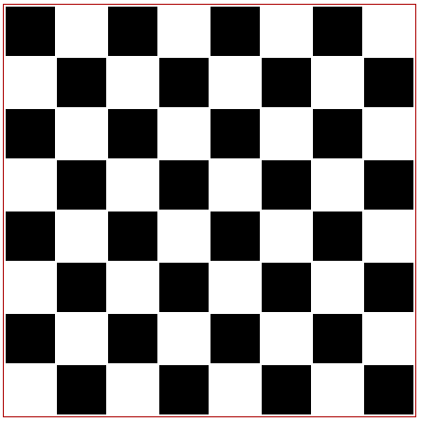

CSS Based CHESS Board & VIBGYOR

